Slide 1

CAPSTONE PROJECT THE BATTLE OF NEIGHBORHOODS
IBM Applied Data Science Capstone Powered by COURSERA
Presented by: CAROL DCUNHA

Slide 2

CONTENT
Problem Statement
Data
Methodology
Results
Conclusion

Slide 3
PROBLEM STATEMENT
A restaurateur wants to open an Italian restaurant in Manhattan and Queens Borough in the New York City. He needs to find a suitable neighborhood in these boroughs where an Italian restaurant would flourish and earn him profits.

Slide 4
DATA
Foursquare location API to explore Manhattan and Queens
Gather all information of top 5 food joints in the neighborhoods of these boroughs

Slide 5
METHODOLOGY
Download and explore dataset of New York
Use Foursquare API to explore the hoods of Manhattan and Queens
Analyze each neighborhood
Cluster neighborhoods for Manhattan and Queens
Examine clusters and recommend hoods

Slide 6
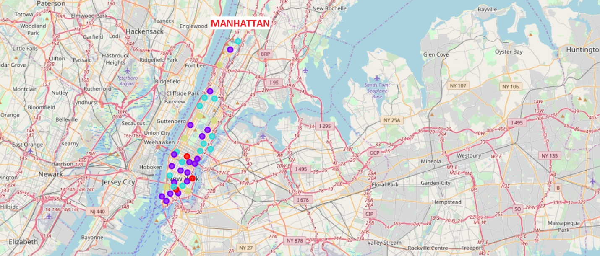
RESULTS
Clustering of hoods in Manhattan

Slide 7
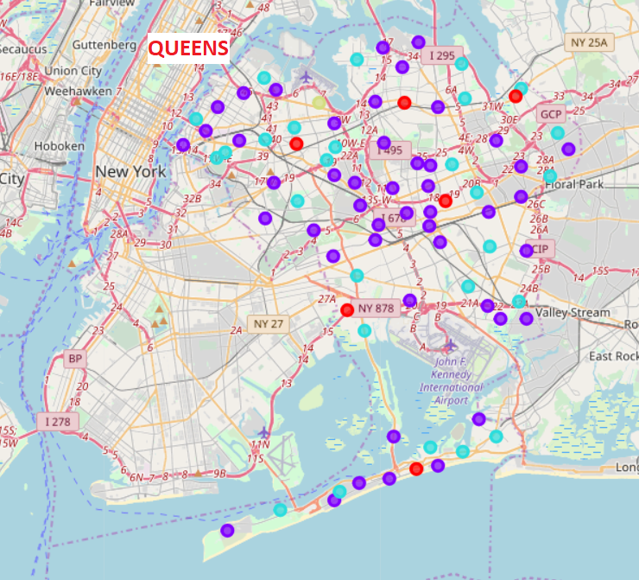
RESULTS
Clustering of hoods in Queens

Slide 8
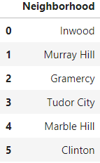
RESULTS
Recommended hoods in Manhattan

Slide 9
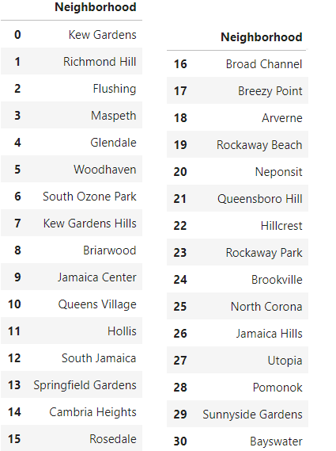
RESULTS
Recommended hoods in Queens

Slide 10
CONCLUSION
Download and explore the top 5 food venues of Manhattan and Queens using Foursquare API
Clustering of venues groups similar hoods and gives an idea about those hoods that are more likely to have Italian restaurants.
Recommendations are made by suggesting hoods that belong to such clusters but haven’t had an Italian restaurant.

Slide 11



THANK YOU

